Slide 1
CourseTrack
Design Phase
College Course Enrollment System

Slide 2
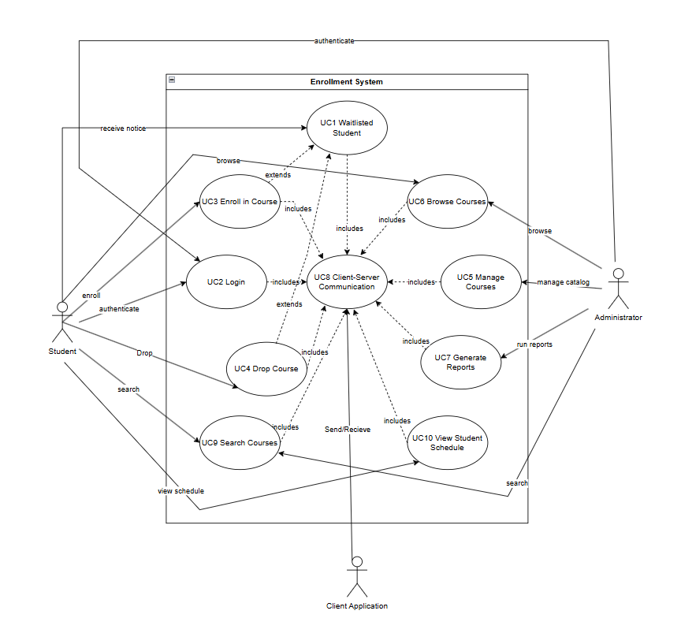
Use Case Diagrams
Main actors: Student, Admin, Client Application
Student and Admin are human users while Client application is a software interface
Student and Admin communicate with server through the client application
Students use enrollment tasks, Admins use system management
Notes:
Interact with software interface with gui
Student
Waitlist student
Enroll in course
Drop course
Browse course
Search course
View student schedule
Admin
Manage courses
Generate reports
Both
Login
Client server communication

Slide 3
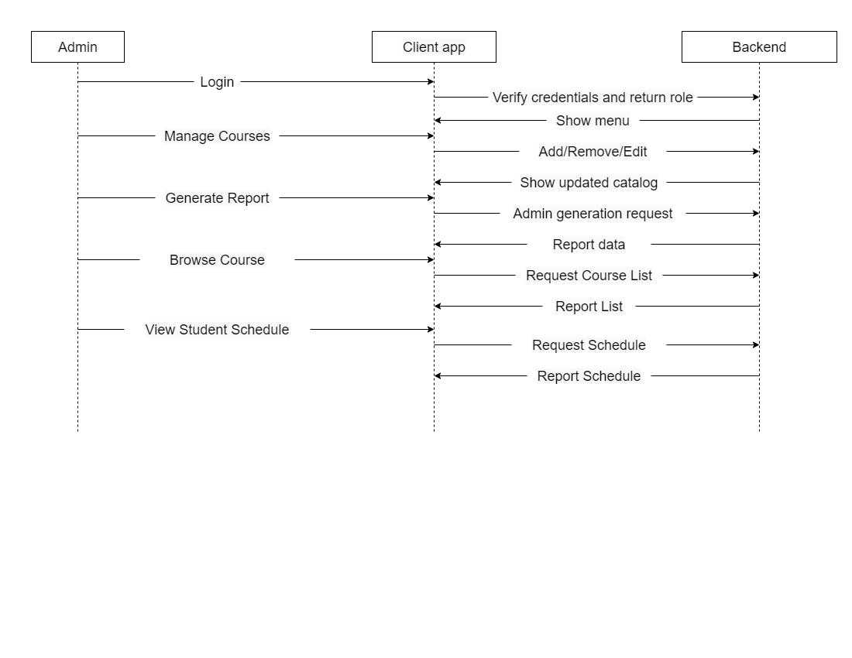
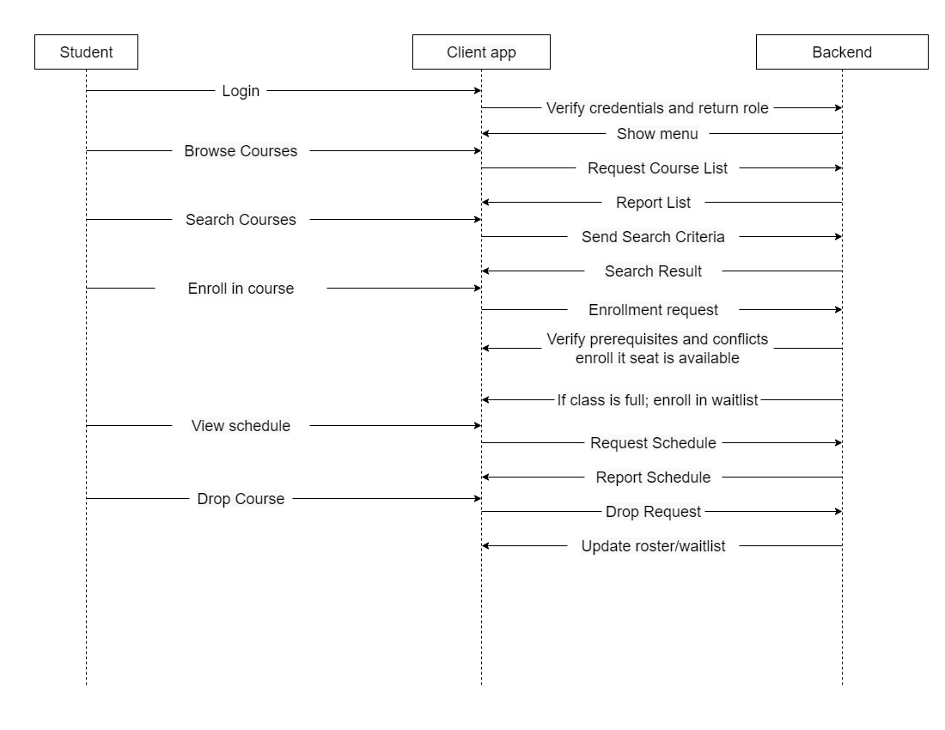
Sequence Diagrams
User interactions is implemented following the “facade” design pattern to simplifies system interactions.

Slide 4
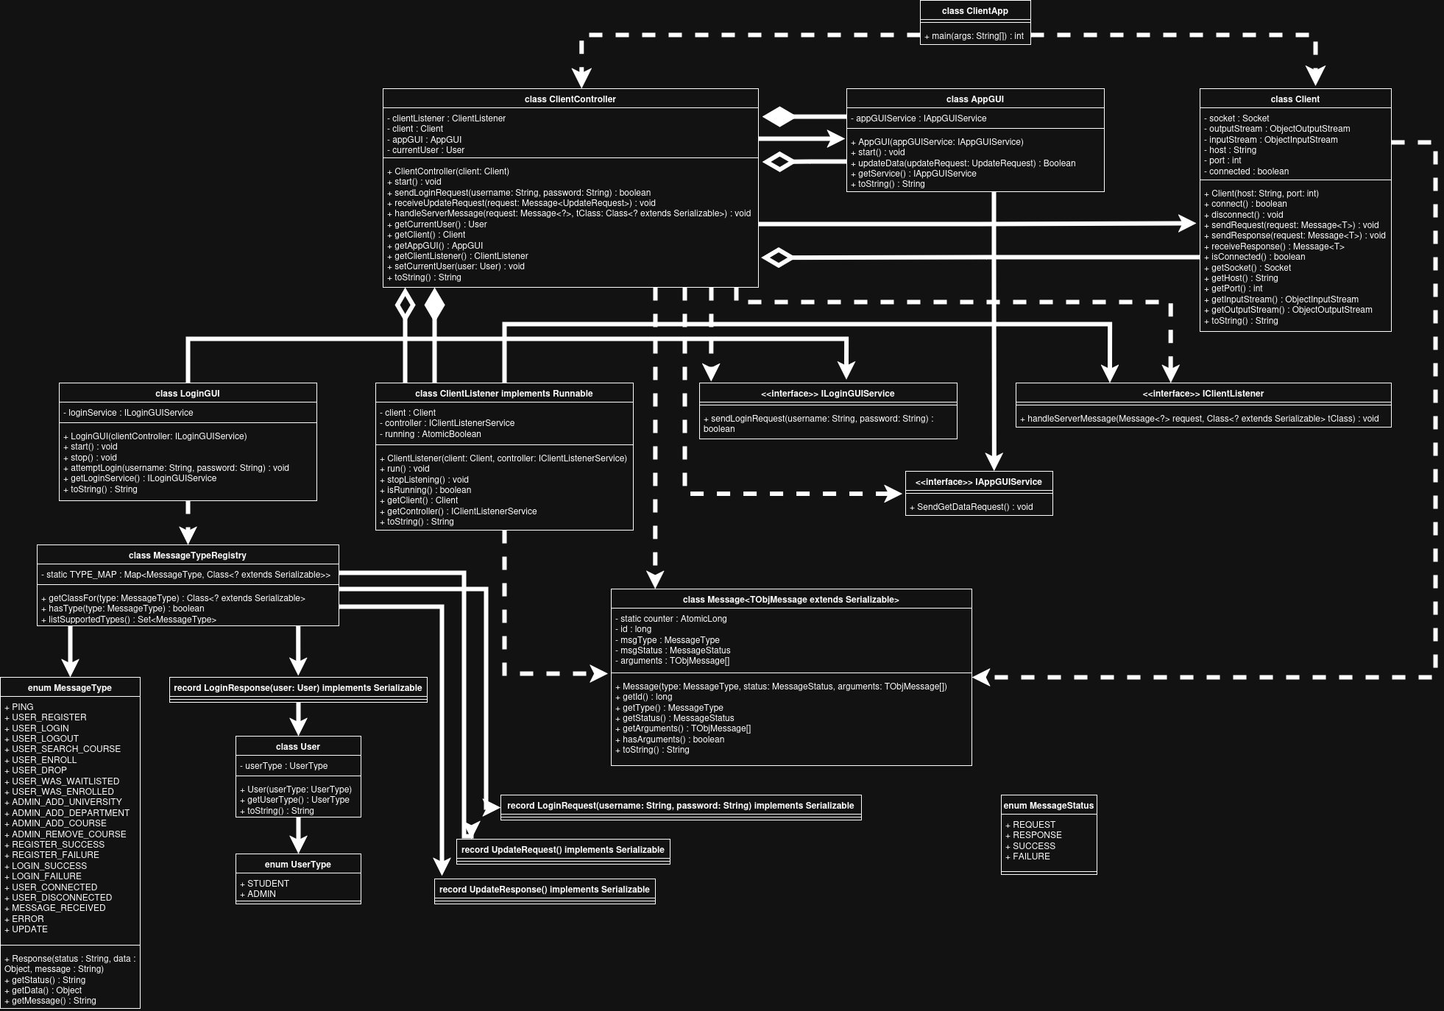

Client Class Diagrams

Slide 5
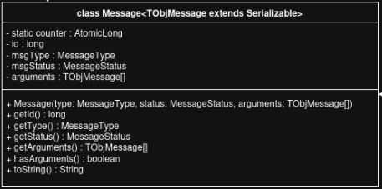

Class Message<TObjMessage>
Why not Obj
Storing data in an Obj is just not desirable.
The data in each request and response isn’t self documenting.
Object[] loginData = new Object[] {username, password }; is fine on the client side, but becomes more confusing once the context is lost on the server side.
If the data was put in out of order the cast would fail
Object[] loginData = new Object[] {password, username }; fails.
Why TObjMessage? Why not String?
Sending non strings would be hard. (Floats, Objects stored in Objects)
A unique conversion would need to be thought of for every request and response
Records solve this. Self documenting, Allows for sending Objects like a User, not overly complex

Slide 6
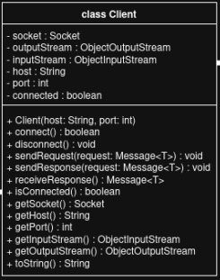
Client Class
Handles socket stream.
Handles the network connection between the client app and the server.
Responsible for sending and receiving serialized messages (Message<TObjMessage>).
Manages socket communication using ObjectInputStream and ObjectOutputStream.
Keeps track of connection state (connected flag).
Encapsulation: all socket isolated in one class.

Slide 7
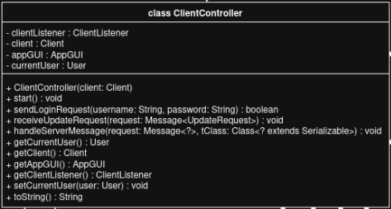
ClientController Class
Acts as a facade between the GUI, network client, and background listener.
Starts and manages the ClientListener thread for asynchronous communication (Server might send a unprompted request, this handles that).
Uses the Client class to send requests (e.g. LoginRequest, UpdateRequest) to the server.
Interprets server responses (e.g. LoginResponse, UpdateResponse) and updates the UI.
Maintains the current user session once login succeeds.

Slide 8
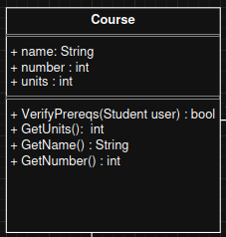
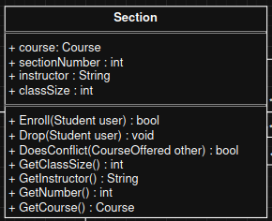
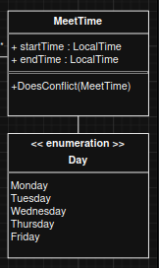
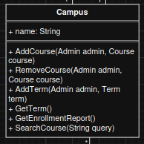
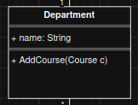
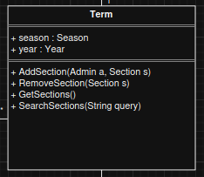
Server Data Classes

Slide 9
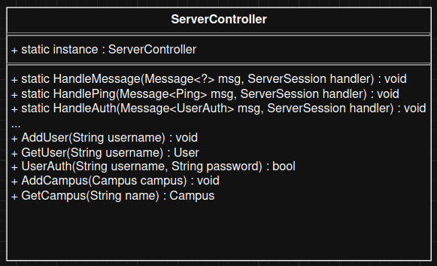
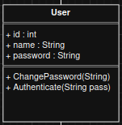
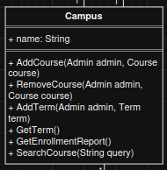
ServerController Class

Slide 10
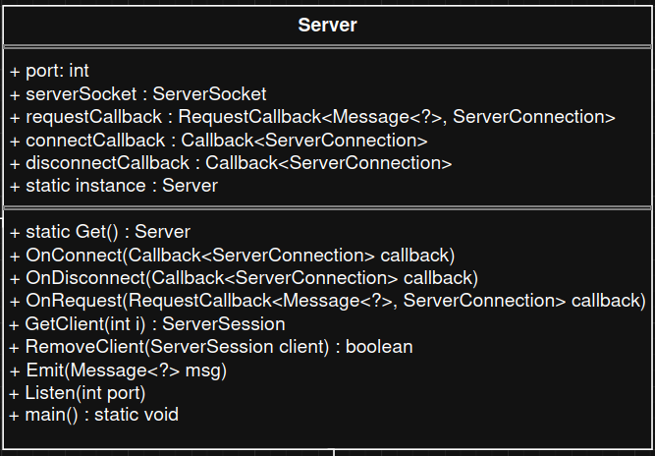
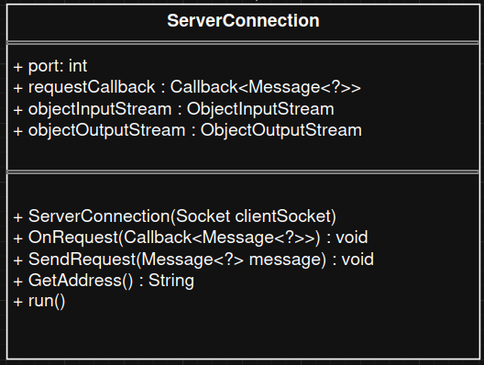
Server & ServerConnection Class

Slide 11
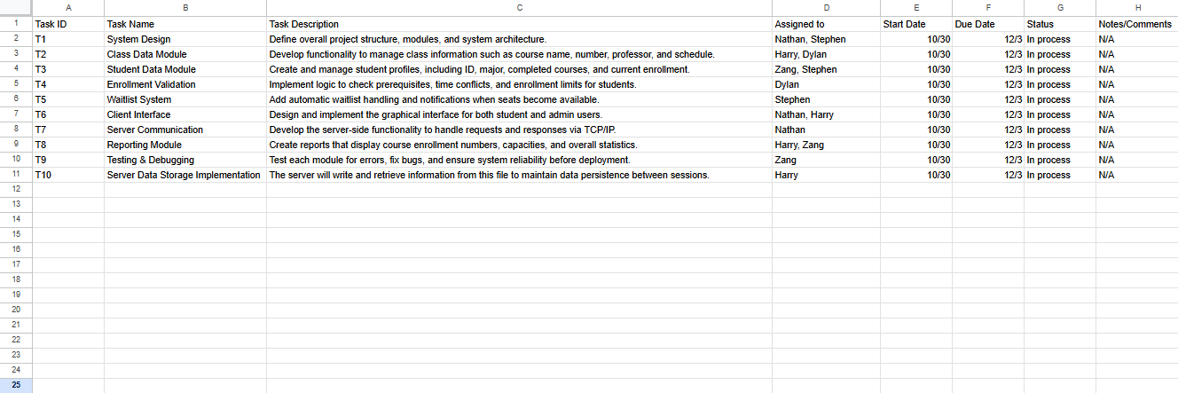
Group Task and Workload Schedule

Slide 12


